Slide 1
OPIM-5272 · Data Management & Business Process Modeling
Sports Team
Management System
Final Sprint Presentation
Damir Subkhankulov
Danilo Tambone
Vitosavero Avila Wibisono
Group 8
1

Slide 2
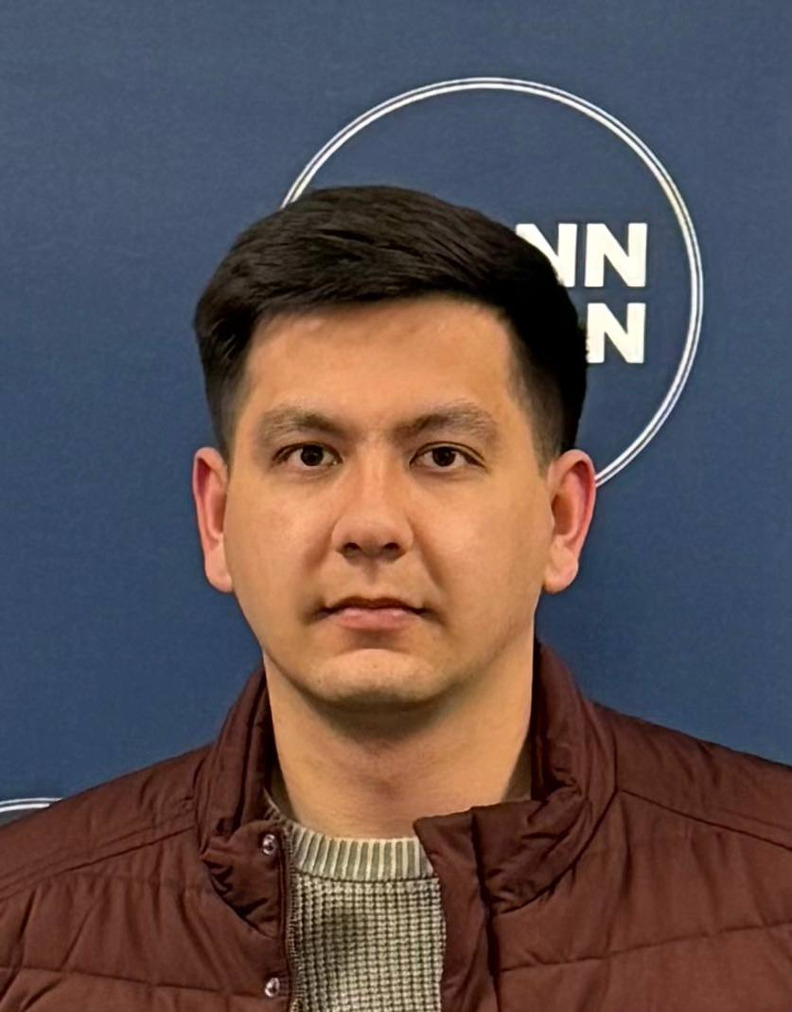
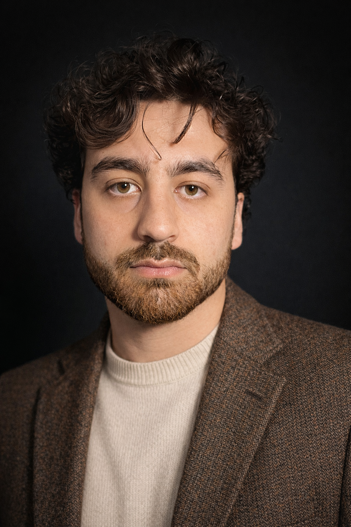
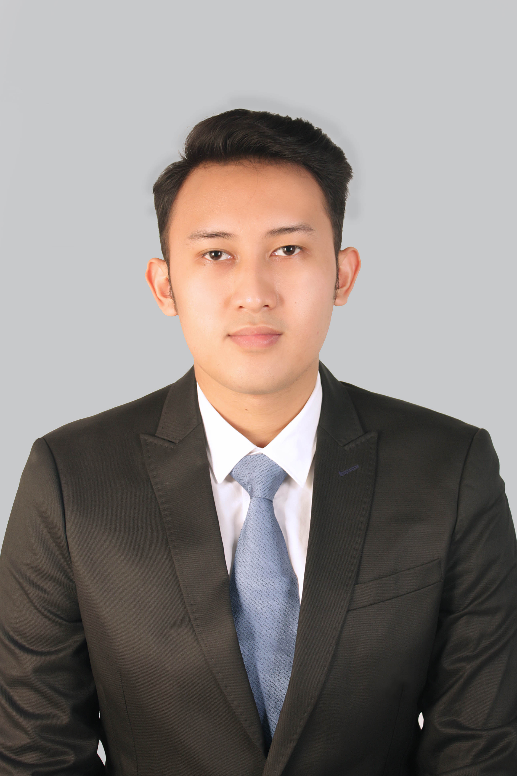
Our Team
01
01
01
Damir Subkhankulov
Danilo Tambone
Vitosavero Avila Wibisono
2

Slide 3
AGENDA
01
Problem Statement
Questions we set out to answer and the data sources used
02
ERD Design
Physical model, EEC hierarchy, and key design decisions
03
Reports — Live Demo
Reports 1 & 3 run live in DBeaver
04
Reports — Overview
Reports 2, 4 & 5 — insights and business value
05
Conclusion
Challenges, lessons learned, and one key recommendation
3

Slide 4
PROBLEM STATEMENT
Key Questions
Data Sources & Schema
Which players are at high injury risk based on workload data?
Are we adequately staffed across all medical specializations?
How does surface type affect player exposure and injury rates?
Can training loads be linked to game-day performance outcomes?
Where are gaps in facility utilization across the season?
team
player
coach / staff / medical_staff
season · game · game_roster
training_session · session_performance
facility
injury_record
MariaDB · 12 entities · 2 associative tables · 3 analytical reports
4

Slide 5
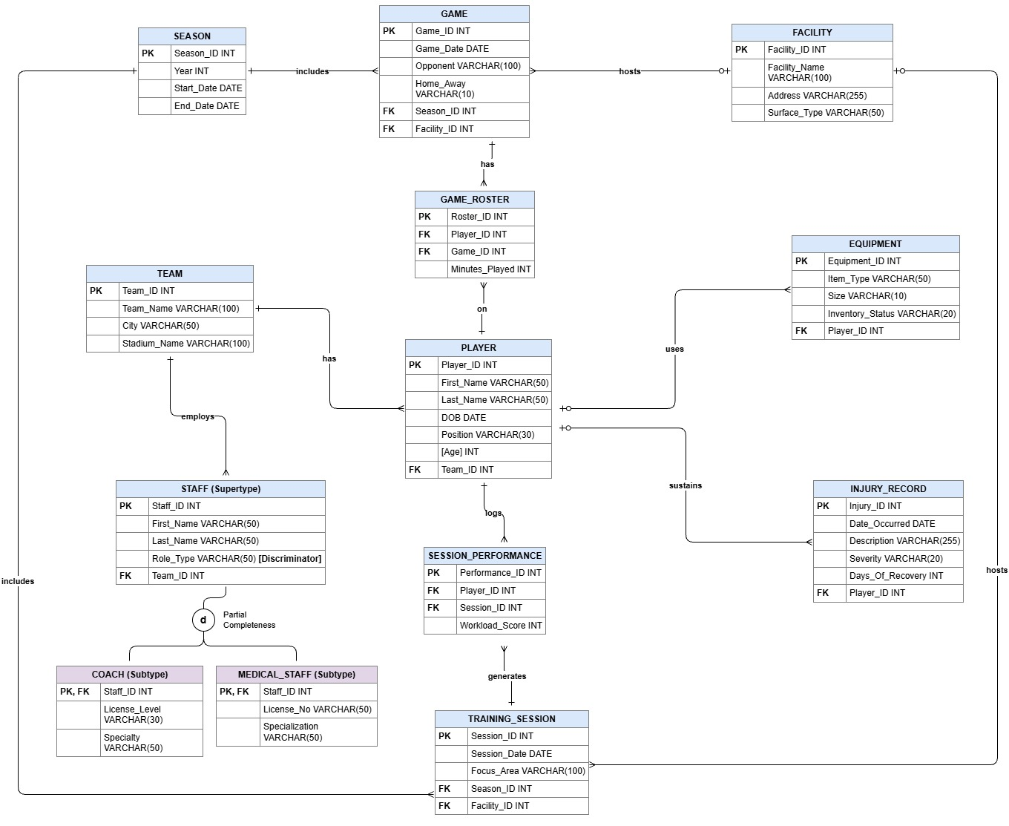
ENTITY-RELATIONSHIP DIAGRAM
EEC Hierarchy
STAFF supertype → COACH & MEDICAL_STAFF
(Disjoint, Partial Completeness)
Resolved M:M
GAME_ROSTER and SESSION_PERFORMANCE
as associative entities with own PKs
Derived Attribute
[Age] computed from DOB, stored only in
application layer, not in DB
Discriminator
Role_Type in STAFF routes records to the
correct subtype without extra JOINs
5

Slide 6
REPORT 1 - LIVE DEMO · Predictive Injury Risk Profiling
SELECT
CONCAT(p.first_name, ' ', p.last_name) AS Player_Name,
UPPER(p.position) AS Position,
ROUND(AVG(sp.workload_score), 0) AS Avg_Workload,
COALESCE(COUNT(ir.injury_id), 0) AS Total_Injuries,
COUNT(DISTINCT sp.session_id) AS Total_Sessions_Tracked,
CASE
WHEN ROUND(AVG(sp.workload_score), 0) > 700 AND COUNT(ir.injury_id) > 0 THEN 'High Risk - Reduce Load'
WHEN ROUND(AVG(sp.workload_score), 0) BETWEEN 500 AND 700 THEN 'Optimal Load'
ELSE 'Review Conditioning'
END AS Injury_Risk_Assessment
FROM player p
JOIN session_performance sp
ON p.player_id = sp.player_id
LEFT JOIN injury_record ir
ON p.player_id = ir.player_id
GROUP BY
p.player_id,
p.first_name,
p.last_name,
p.position
ORDER BY
Avg_Workload DESC;
3 Tables Joined
player → session_performance → injury_record
Nested Function
ROUND(AVG(workload_score), 0)
CASE Risk Tiers
High Risk / Optimal Load / Review Conditioning
Aggregates
AVG · COUNT · COALESCE
Single-Row Fns
CONCAT · UPPER · ROUND
6

Slide 7
REPORT 3 - LIVE DEMO · Player Surface Exposure & Game Minute Distribution
SELECT
UPPER(f.surface_type) AS Field_Surface,
LEFT(p.position, 3) AS Pos_Code,
CONCAT(p.first_name, ' ', p.last_name) AS Player_Name,
COUNT(gr.roster_id) AS Total_Games_Played,
SUM(gr.minutes_played) AS Total_Minutes_Played,
ROUND(AVG(gr.minutes_played), 0) AS Avg_Minutes_Per_Game,
CASE
WHEN UPPER(f.surface_type) = 'TURF'
AND SUM(gr.minutes_played) > 300 THEN 'High Exposure Risk'
WHEN UPPER(f.surface_type) = 'TURF'
AND SUM(gr.minutes_played) BETWEEN 100 AND 300 THEN 'Moderate Exposure Risk'
ELSE 'Acceptable Exposure'
END AS Surface_Exposure_Assessment
FROM player p
JOIN game_roster gr
ON p.player_id = gr.player_id
JOIN game g
ON gr.game_id = g.game_id
JOIN facility f
ON g.facility_id = f.facility_id
GROUP BY
f.surface_type,
p.player_id,
p.first_name,
p.last_name,
p.position
ORDER BY
f.surface_type ASC,
Total_Minutes_Played DESC;
4 Tables Joined
player → game_roster → game → facility
Nested Function
ROUND(AVG(minutes_played), 0)
CASE Tiers
High / Moderate / Acceptable Exposure
Aggregates
COUNT · SUM · AVG
Single-Row Fns
UPPER · CONCAT · ROUND · LEFT
7

Slide 8
REPORTS — ANALYTICAL OVERVIEW
R2
Medical Staff Specialization Capacity & Distribution Audit
Groups practitioners by specialization, surfaces headcount per discipline, flags single-point-of-failure gaps, and lists all practitioners via GROUP_CONCAT.
Answers: Are we compliant? Where are staffing shortfalls before they become crises?
R4
Training Session Effectiveness by Coach — Coach Session Load Analysis
Average player workload, 4 tables involved (staff, coach, training session, session performance), AVG, CONCAT, and single-row functions used.
Answers: Are we hitting the right training intensity? Are different coaches over or under load players?
R5
Player Performance Trends by Season
Seasonal player output, each game, total minutes and average training workload. Classification of players. 5 tables involved (player, session_performance, training session, season, game roaster, game)
Answers: Are our player improving each season? Can we manage player contract using these statistics?
8

Slide 9
CONCLUSION
Challenges Faced
EEC Boundary
Complex joins, aggregates, and CASE logic
Database integrity across all entities
Add a CONTRACT table linked to PLAYER
Track salary and contract duration
Measure financial impact of injuries
Support roster and budget planning
ONE KEY RECOMMENDATION
• 12 Entities
• 2 Associative Tables
• 5 Analytical Reports
9

Slide 10
Thank You
10

